Slide 1
Dimensionality Reduction
COMP6246: Machine Learning Technologies (MSc)
Dr Daniela Mihai (a-d.mihai@soton.ac.uk)
20 October 2026

Slide 2
Lecture Outline
By the end of this lecture, you will be able to
  Understand the benefits of Dimensionality Reduction
  Understand different approaches to dimensionality reduction
  Understand how different dimensionality reduction algorithms work
    Principal Component Analysis and variants
    Locally Linear Embedding
    t-SNE
    UMAP

Slide 3
Why Reduce Dimensions?
To remove redundant or irrelevant features
  Too many features can considerably slow down training
To mitigate Curse of Dimensionality
  High-dimensional data tends to be sparse and increases the risk of overfitting
  They can also make it much harder to find the best solution
Useful for data visualization in 2D or 3D
  Can’t visualize all features at once
  2D or 3D visualization will provide intuitive understanding of data
  It makes sense to visualize the dimensions with the largest variance to understand the data better

Slide 4
Why Reduce Dimensions?
To make the algorithms scalable and faster
  Reducing computational complexity
Data Compression
  for easy storage and retrieval
Warnings!
  Dimensionality reduction may lead to loss of information, which can lead to worse performance sometimes
  Dimensionality reduction can sometimes reduce the interpretability of the data

Slide 5
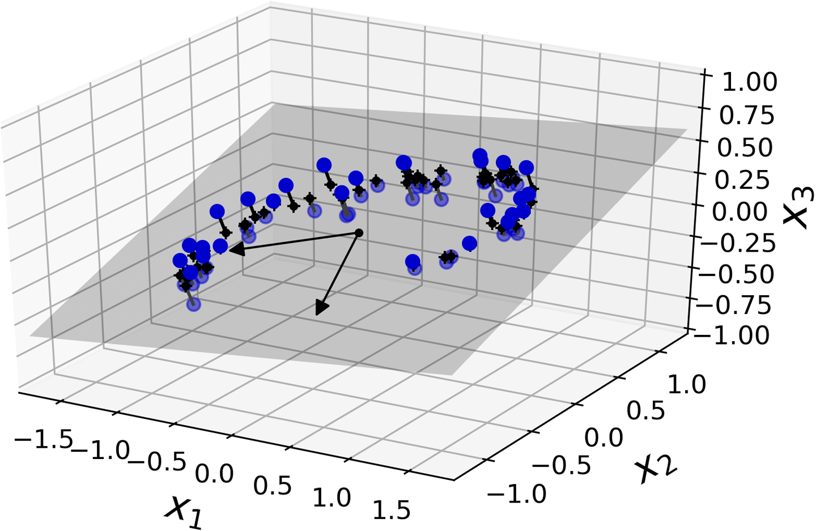
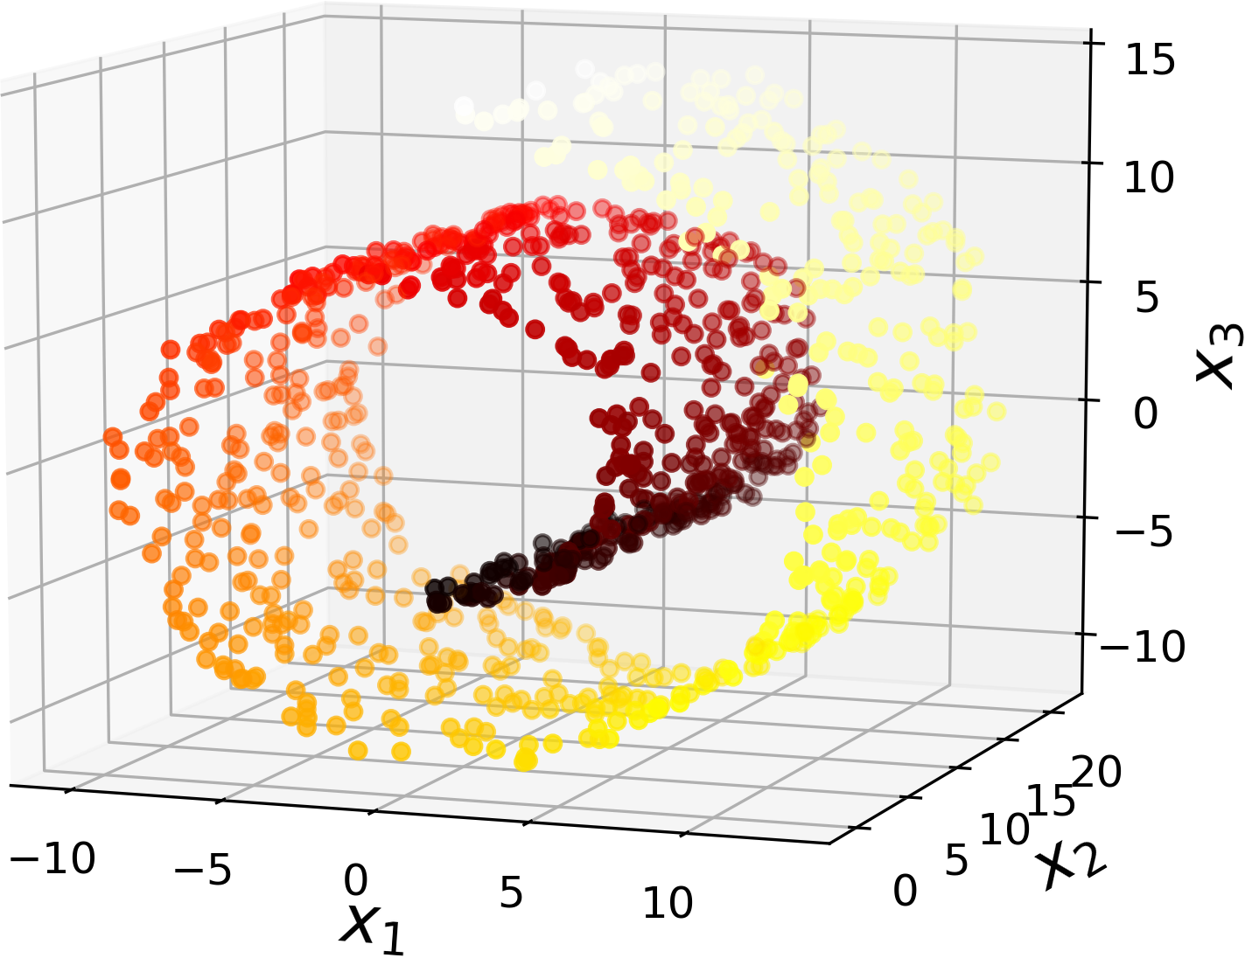
Approaches
Projection
  Assumes a global linear relationship.
  It maps high-dimensional points onto a flat hyperplane or subspace.
Manifold
  Assumes the data lives on a non-linear, lower-dimensional manifold embedded in a higher-dimensional space.

Slide 6
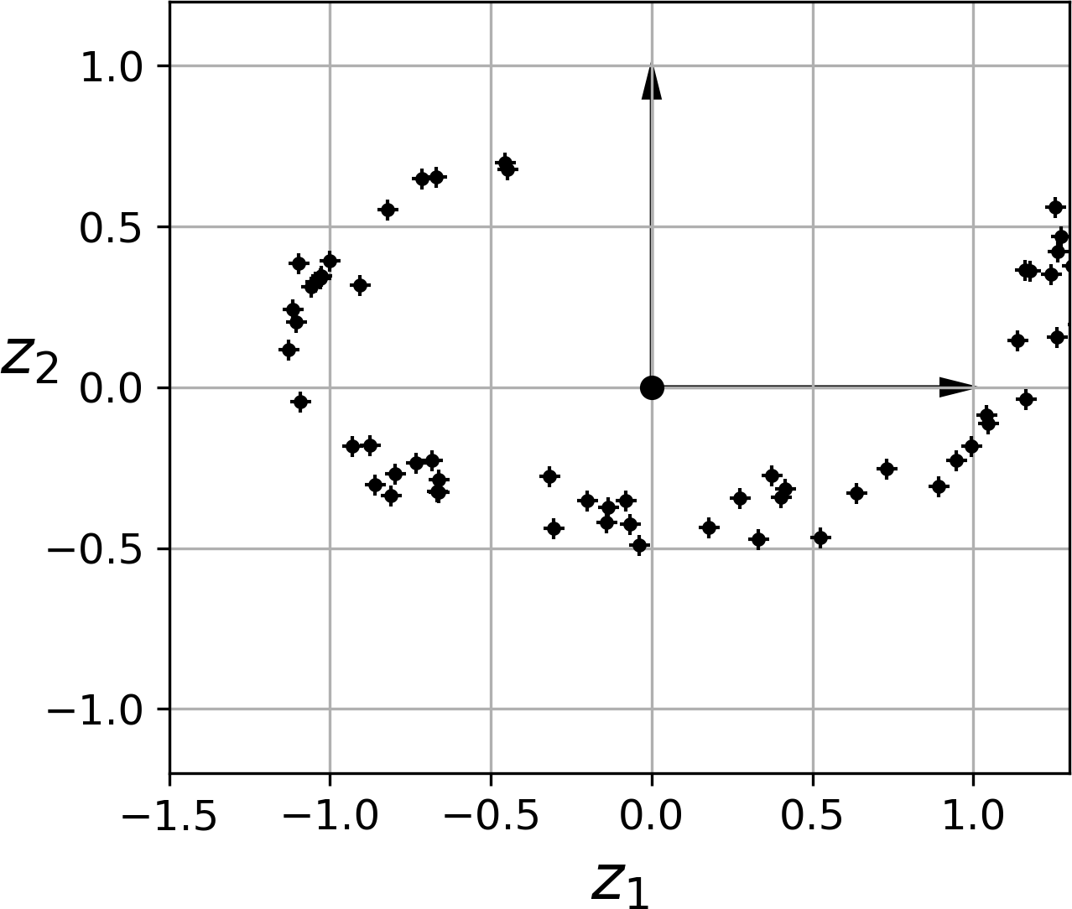
Approaches – Projection
In most real-world problems, training data is not spread uniformly across all the dimensions
  Features may not change much
  Highly correlated features (e.g. MNIST digits)
The training data might lie within (or close to) a lower-dimensional space within the actual higher-dimensional space
3D
2D

Slide 7
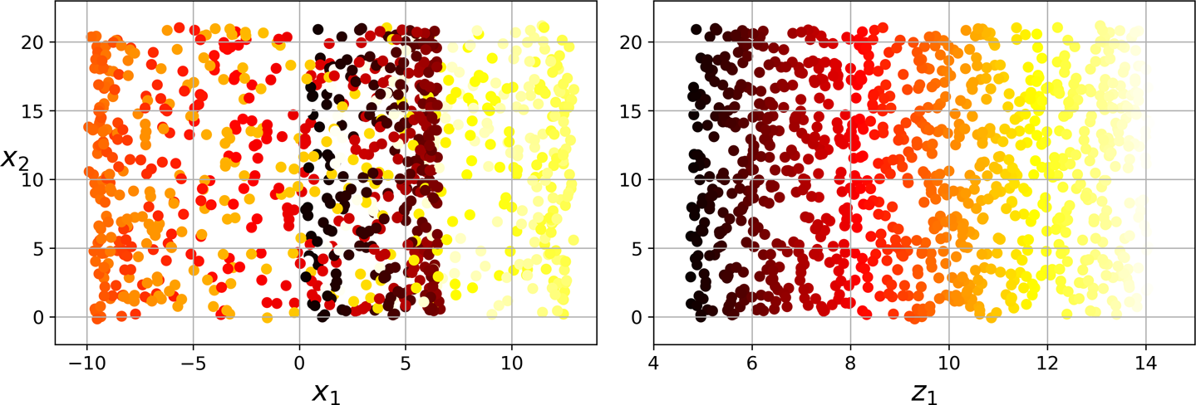
Approaches – Projection II
Projection may not always be the best approach
Squashed
Swiss roll
Unrolled

Slide 8
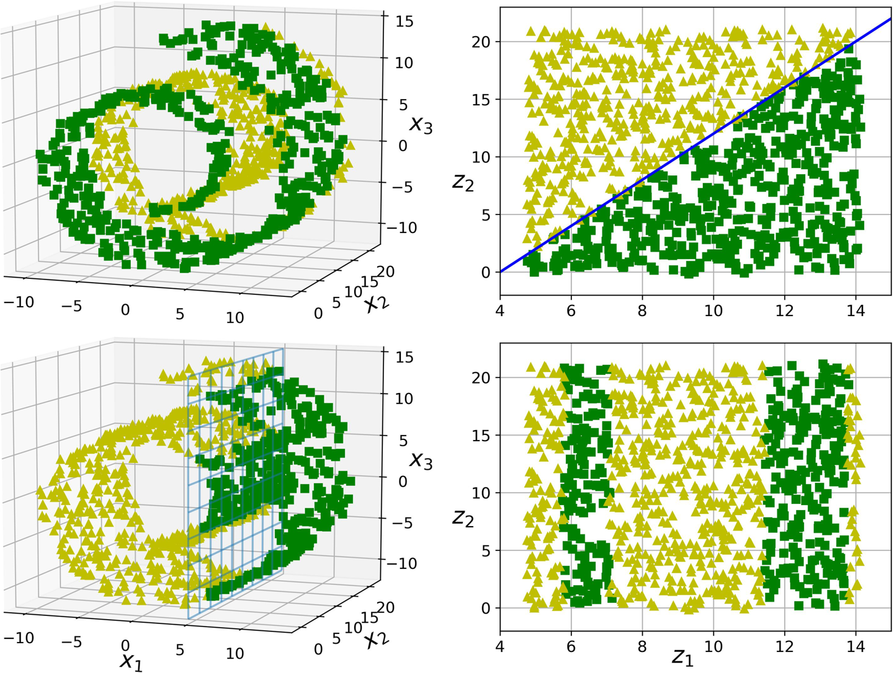
Approaches – Manifold Learning
Many dimensionality reduction algorithms work by modelling the manifold on which the training instances lie
Manifold assumption
  Most data lies close to a much lower-dimensional manifold
The task at hand will be simpler if expressed in the lower-dimensional space of the manifold
  But not always

Slide 9
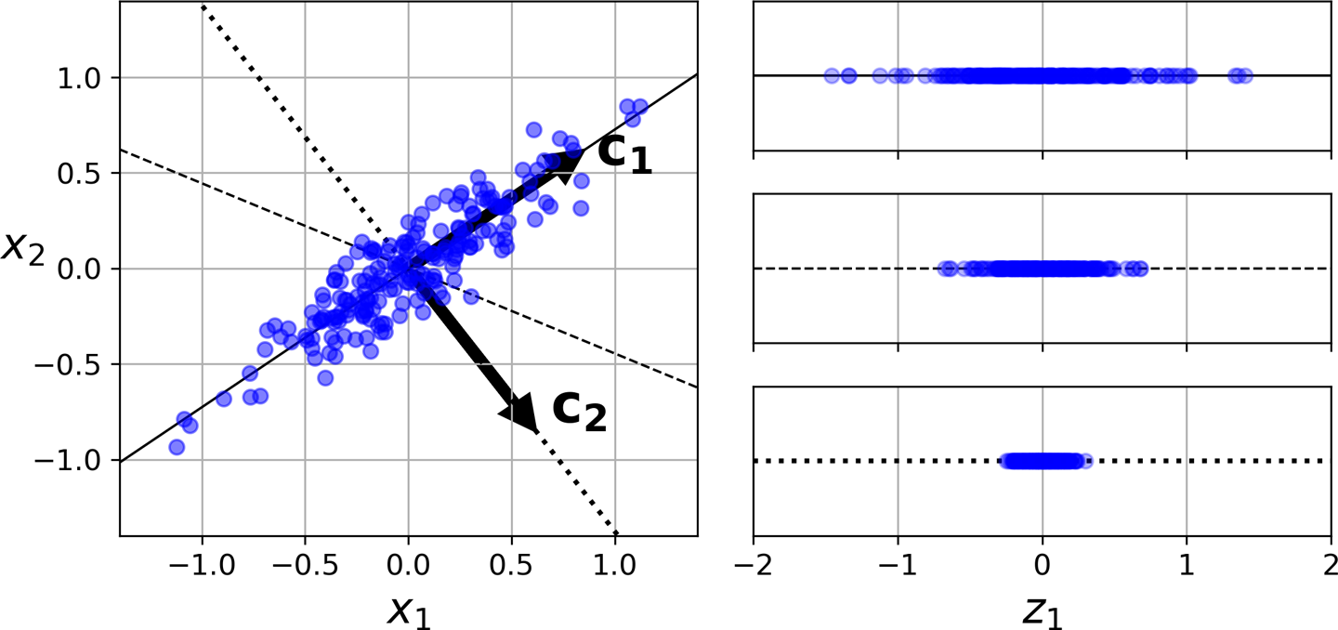
Principal Component Analysis (PCA)
Most popular dimensionality reduction technique
Identifies the lower-dimensional hyperplane to project the data
The data projected onto C1 preserves most variance in the data
C1 also minimizes the mean squared distance between the original dataset and its projection onto that axis

Slide 10
PCA steps
Standardise the data
  - mean centering, scaling variance
Calculate Covariance Matrix
  - to understand the feature correlations present in the data
Eigendecomposition (or SVD)
  - Either eigendecomposition or SVD to find eigenvalues and eigenvectors
Select Principal Components (PCs)
  - rank the eigenvalues and choose the top k eigenvectors (components)
Project the data onto the principal components to obtain the reduced-dimensionality data.

Slide 11
Finding Principal Components
PCA transforms a dataset with possibly correlated features into a new set of uncorrelated variables called principal components
The principal components (PCs) are ordered such that the first few retain most of the variation in the original dataset
The first PC is the axis that accounts for the largest variance
The second PC is orthogonal to the first one and accounts for the largest amount of the remaining variance
The third component is orthogonal to the first two and so on (as many axes as the number of dimensions in the dataset)
PCA assumes that the data is centred around the origin (0,0)
  So, you start with centring the data around (0,0)

Slide 12
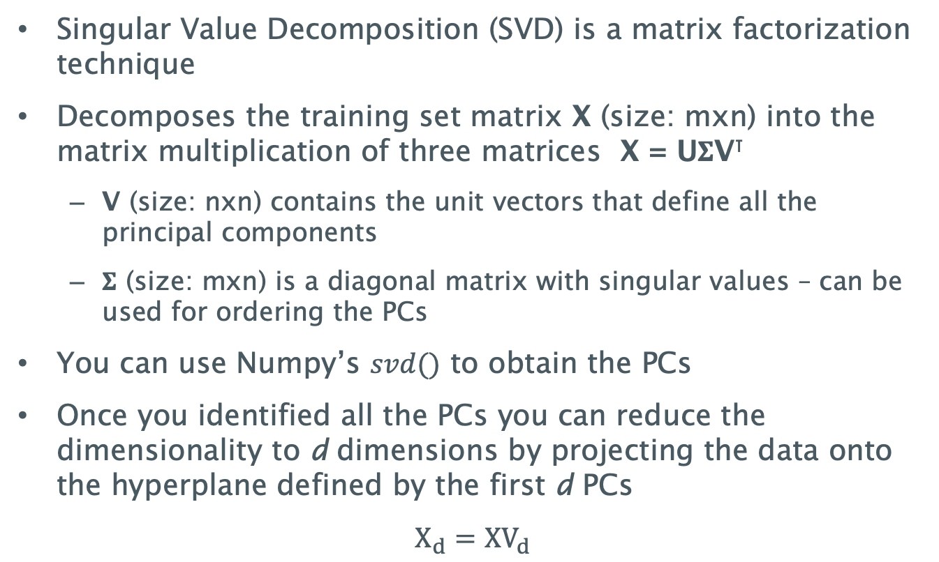
Singular Value Decomposition
Singular Value Decomposition (SVD) is a matrix factorization technique
Decomposes the training set matrix X (size: mxn) into the matrix multiplication of three matrices X = U$Σ$V⊺
  V (size: nxn) contains the unit vectors that define all the principal components
  $Σ$ (size: mxn) is a diagonal matrix with singular values – can be used for ordering the PCs
You can use Numpy’s $svd()$ to obtain the PCs
Once you identified all the PCs you can reduce the dimensionality to d dimensions by projecting the data onto the hyperplane defined by the first d PCs
$$X_{d}=XV_{d}$$

Slide 13
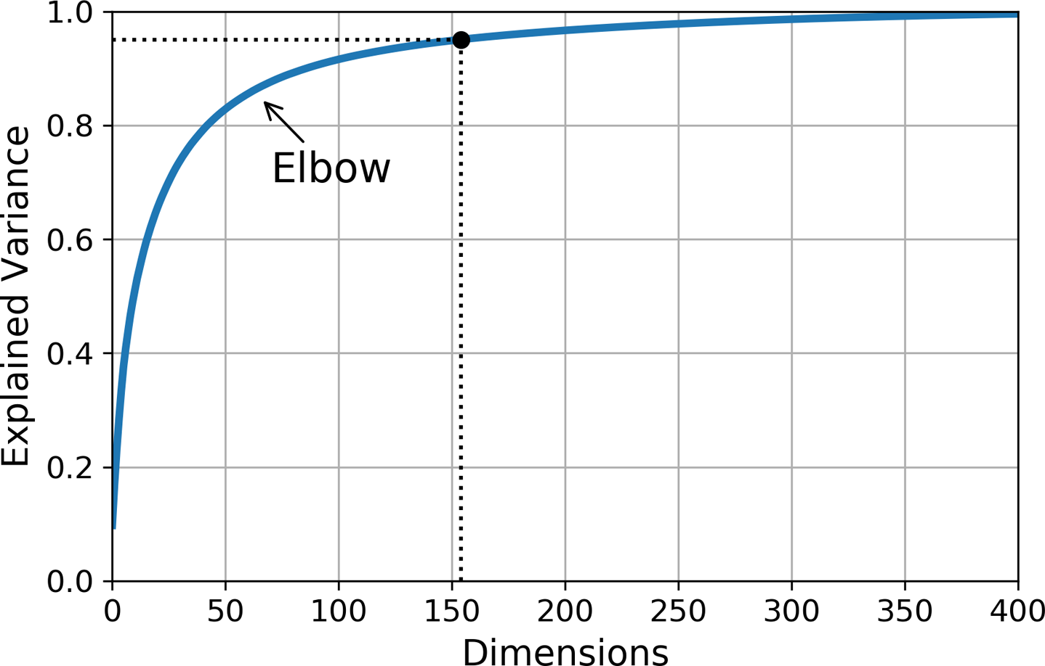
Explained Variance
Explained Variance indicates the proportion of the dataset’s variance that lies along each principal component
You can use it to choose the number of dimensions to reduce the data to
  E.g. choose the number of dimensions that add up to a sufficiently large portion of the variance ~95%
  However, for visualization choose only top 2 or 3 PCs
Explained variance plot
(also known as Scree plot)
  explained variance as a
  function of the number of
  dimensions

Slide 14
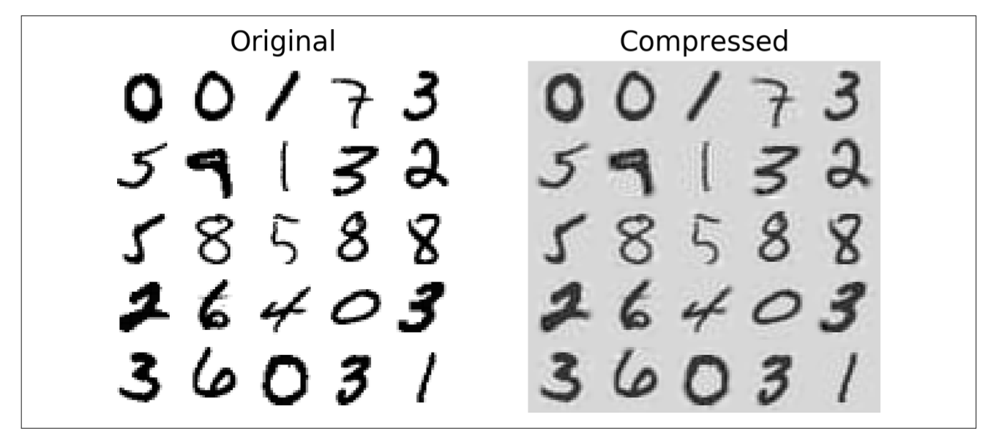
Example of compression and reverse.
E.g. MNIST compression that preserves 95% variance (with only 20% of the features)
It’s also possible to recover (almost) the original data by applying the inverse transformation of the PCA projection.

Slide 15
PCA variants
Randomized PCA
  Uses a stochastic algorithm to find an approximation of the first d principal components quickly.
  Faster than full PCA
Incremental PCA
  Allows for splitting the training set into mini-batches and feeding one mini-batch at a time.
  Useful for large training sets and for applying PCA online
Kernel PCA
  the kernel trick can be used to perform complex nonlinear projections for dimensionality reduction.
  Preserves clusters of instances after projection, or sometimes even unrolling datasets that lie close to a twisted manifold

Slide 16
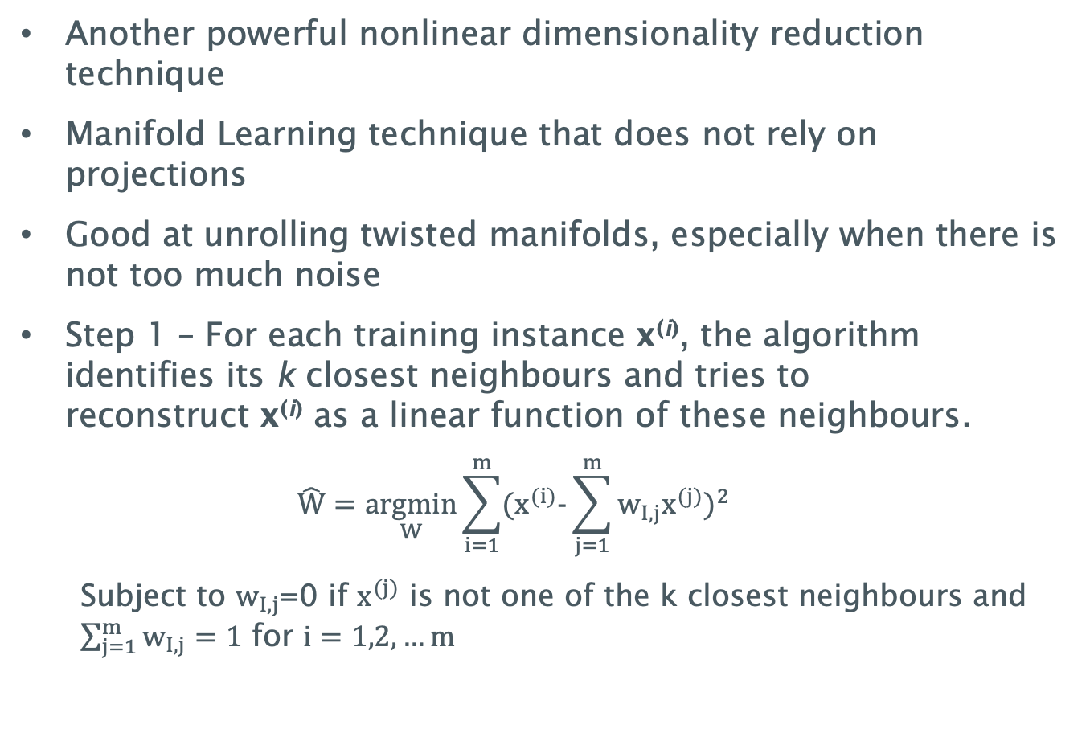
Locally Linear Embedding
Another powerful nonlinear dimensionality reduction technique
Manifold Learning technique that does not rely on projections
Good at unrolling twisted manifolds, especially when there is not too much noise
Step 1 – For each training instance x^{(i)}, the algorithm identifies its k closest neighbours and tries to reconstruct x^{(i)} as a linear function of these neighbours.
  $$\hat{W}=\underset{W}{argmin}{\sum_{i=1}^{m}{{(x^{(i)}−\sum_{j=1}^{m}{w_{I,j}x^{(j)}})}^{2}}}$$
  Subject to $w_{I,j}$=0 if $x^{(j)}$ is not one of the k closest neighbours and $\sum_{j=1}^{m}{w_{I,j}=1}$ for $i=1,2,…m$

Slide 17
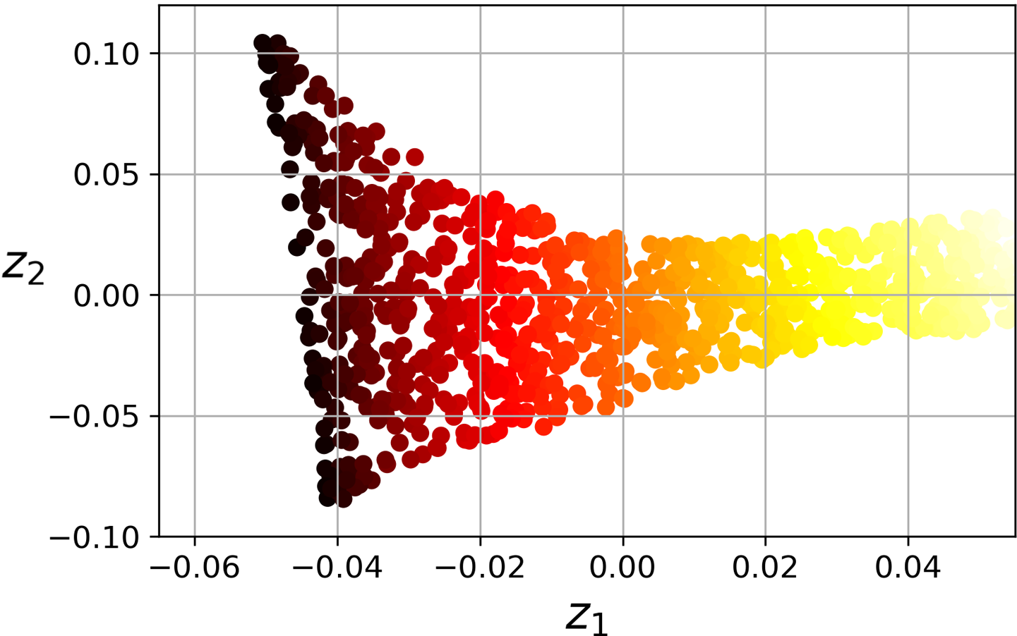
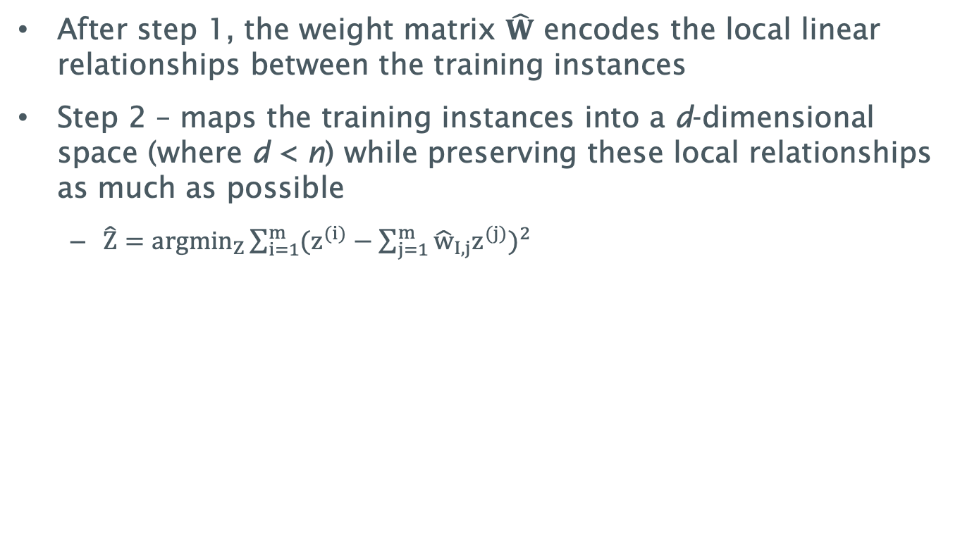
Locally Linear Embedding II
After step 1, the weight matrix $\hat{W}$ encodes the local linear relationships between the training instances
Step 2 – maps the training instances into a d-dimensional space (where d < n) while preserving these local relationships as much as possible
  $\hat{Z}=\underset{Z}{argmin}{\sum_{i=1}^{m}{{(z^{(i)}−\sum_{j=1}^{m}{{\hat{w}}_{I,j}z^{(j)}})}^{2}}}$
Notes:
It looks very similar to the first step, but instead of keeping the instances fixed and finding the optimal weights, we are doing the reverse: keeping the weights fixed and finding the optimal position of the instances’

Slide 18
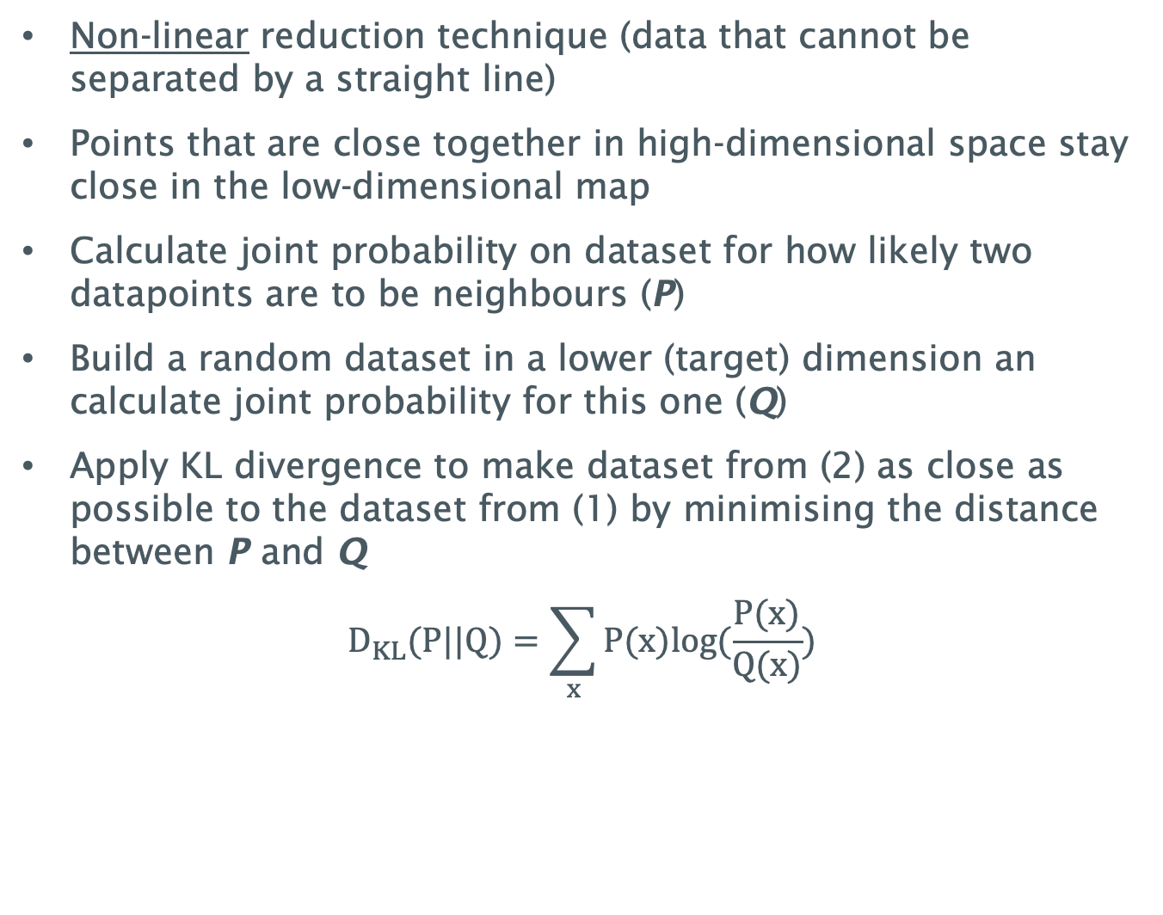
t-distributed Stochastic Neighbour Embedding (t-SNE)
Non-linear reduction technique (data that cannot be separated by a straight line)
Points that are close together in high-dimensional space stay close in the low-dimensional map
Calculate joint probability on dataset for how likely two datapoints are to be neighbours (P)
Build a random dataset in a lower (target) dimension an calculate joint probability for this one (Q)
Apply KL divergence to make dataset from (2) as close as possible to the dataset from (1) by minimising the distance between P and Q
$$D_{KL}(P||Q)=\sum_{x}{P(x)log(\frac{P(x)}{Q(x)})}$$
Notes:
Kullback–Leibler (KL) divergence is a measure from information theory that quantifies how one probability distribution differs from a second, reference probability distribution. It’s often used to compare how well a model approximates a true distribution.

Slide 19
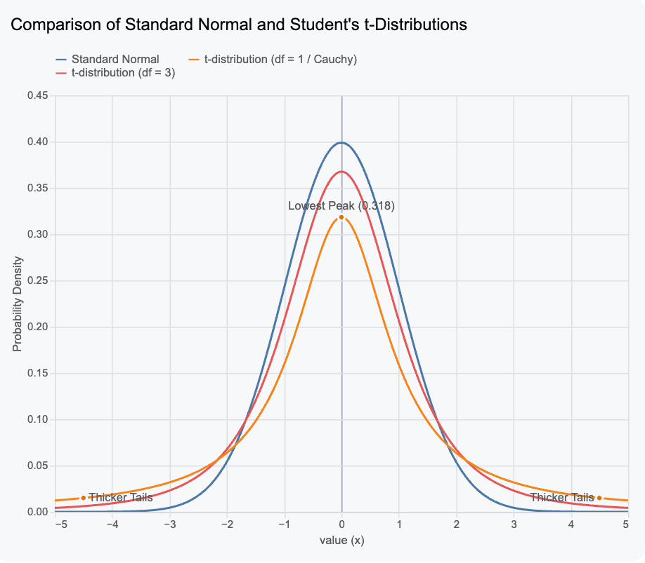
t-distributed Stochastic Neighbour Embedding (t-SNE) – Why t?
P (high-dim): Gaussian, width set per point by perplexity
Q (low-dim): Student-t with 1 degree of freedom, a heavy tail
  Avoids crowding tail
  Keeps clusters separated

Slide 20
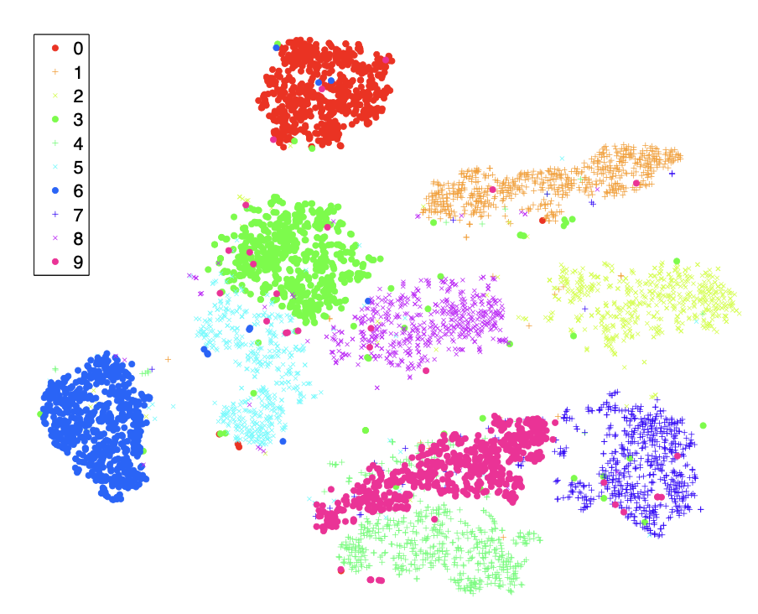
t-distributed Stochastic Neighbour Embedding (t-SNE) (continued)
Note: KL divergence is not symmetric
t-SNE is often used to visualise complex datasets into two and three dimensions, allowing us to understand more about underlying patterns and relationships in the data.
!! Preserves local neighbourhoods, but not in-between cluster distances or densities in the original space!
Use cases:
  Visualizing word embeddings
  Exploring large image
  datasets –
  useful in medical imaging
  (e.g. MNIST, EEG data, etc)
MNIST visualization using t-SNE (Maaten and Hinton 2008)
Notes:
Kullback–Leibler (KL) divergence is a measure from information theory that quantifies how one probability distribution differs from a second, reference probability distribution. It’s often used to compare how well a model approximates a true distribution.

Slide 21
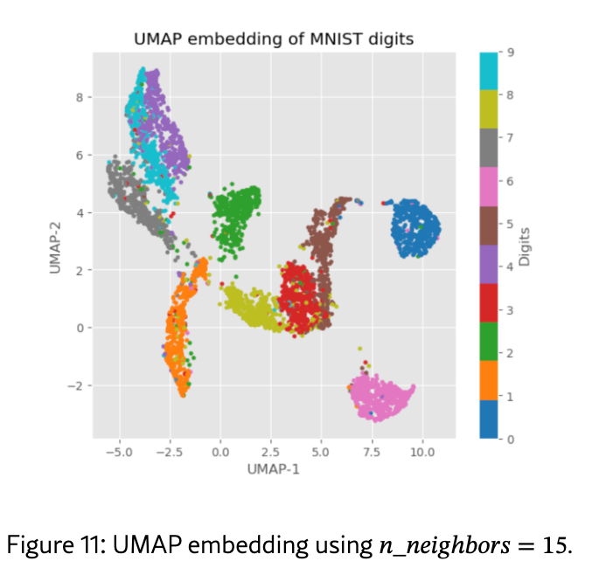
UMAP – the modern alternative
Novel manifold learning technique for dimension reduction.
Similar to t-SNE, but arguably preserves more of the global structure with superior run-time performance.
Builds a weighted nearest-neighbour graph of the data and optimises a low-dimensional layout that preserves its structure.
Caution for both UMAP & t-SNE:
  Interpret cluster sizes and
  inter-cluster distances with caution!
  Better global structure,
    Kobak and Linderman (2021) –
      showed t-SNE + PCA also works;
MNIST visualization using UMAP (https://arxiv.org/html/2601.06168)

Slide 22
PCA vs LLE vs t-SNE vs UMAP
 | PCA | LLE | t-SNE | UMAP
Type | Linear | Non-linear | Non-linear | Non-linear
Goal | Preserves global variance | Preserves local neighborhoods | Preserves pairwise similarities | Preserves local + some global
Scalability | High | Medium | Low | Medium
Best for | Preprocessing Feature selection/ engineering; Noise reduction | Manifold Learning, Preprocessing in non-linear data | Visualization only | Visualization, preprocessing

Slide 23
Summary
In this lecture, we looked at
  The uses and limitations of dimensionality reduction techniques
  How different dimensionality reduction techniques work
    PCA and variants
    LLE
    t-SNE
    UMAP
  Compared these techniques to understand when to select each technique

Slide 24
Questions?

